Slide 1
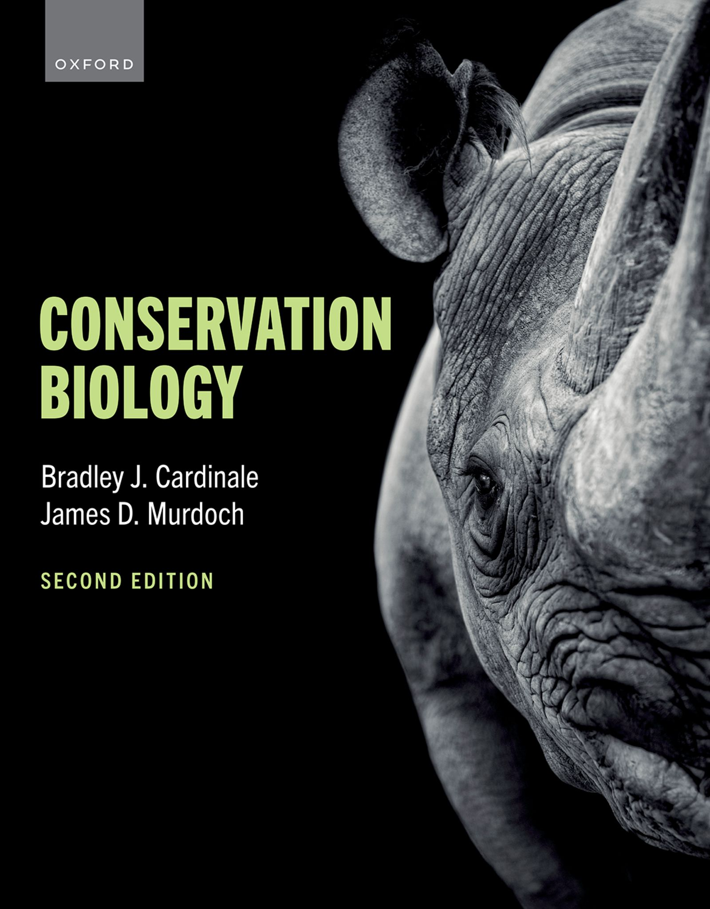
CONSERVATION BIOLOGY
By Bradley J. Cardinale and James D. Murdoch

Slide 2
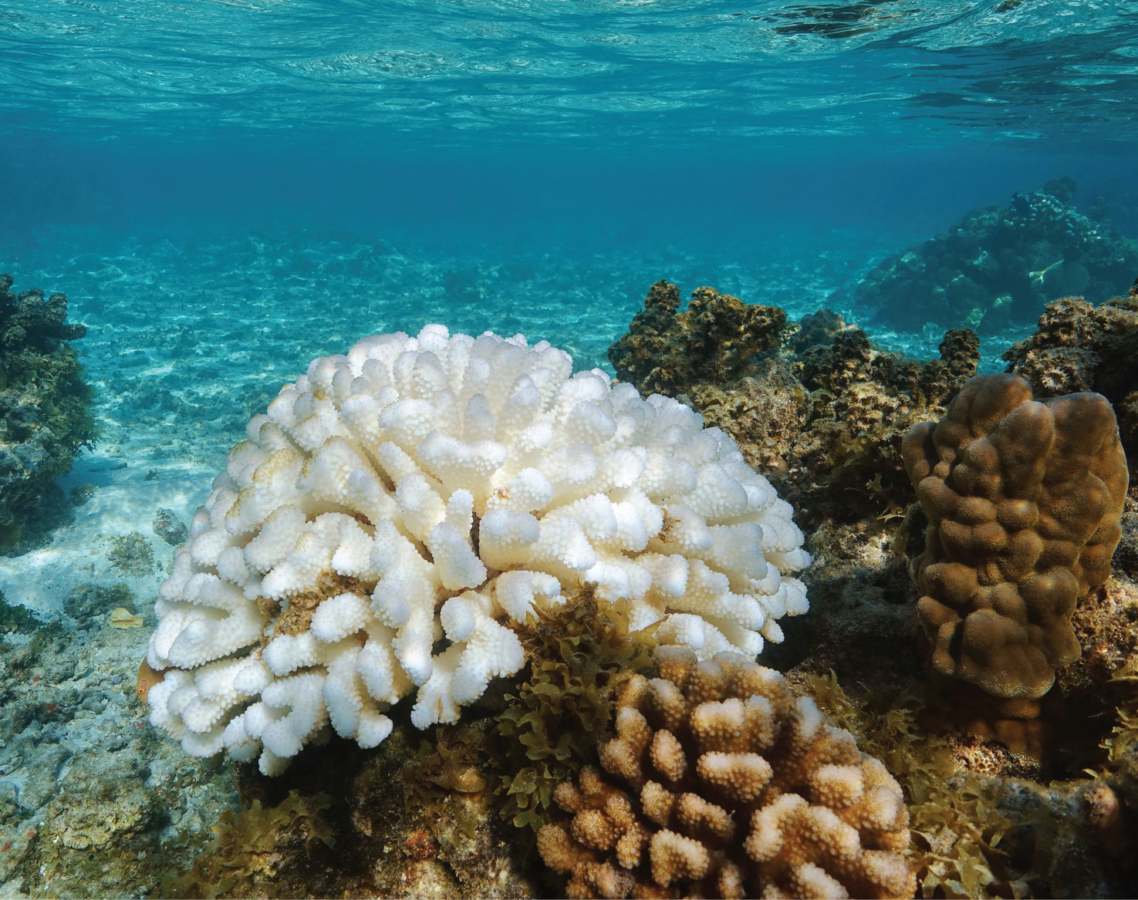
2
Notes:
Pocillopora, or cauliflower coral, is a genus of Scleractinia (stony) corals that occur in the Pacific and Indian Oceans. Many types of stony coral are threatened by climate change as warming water causes them to expel the symbiotic algae (zooxanthellae) living in their tissues and undergo bleaching.

Slide 3
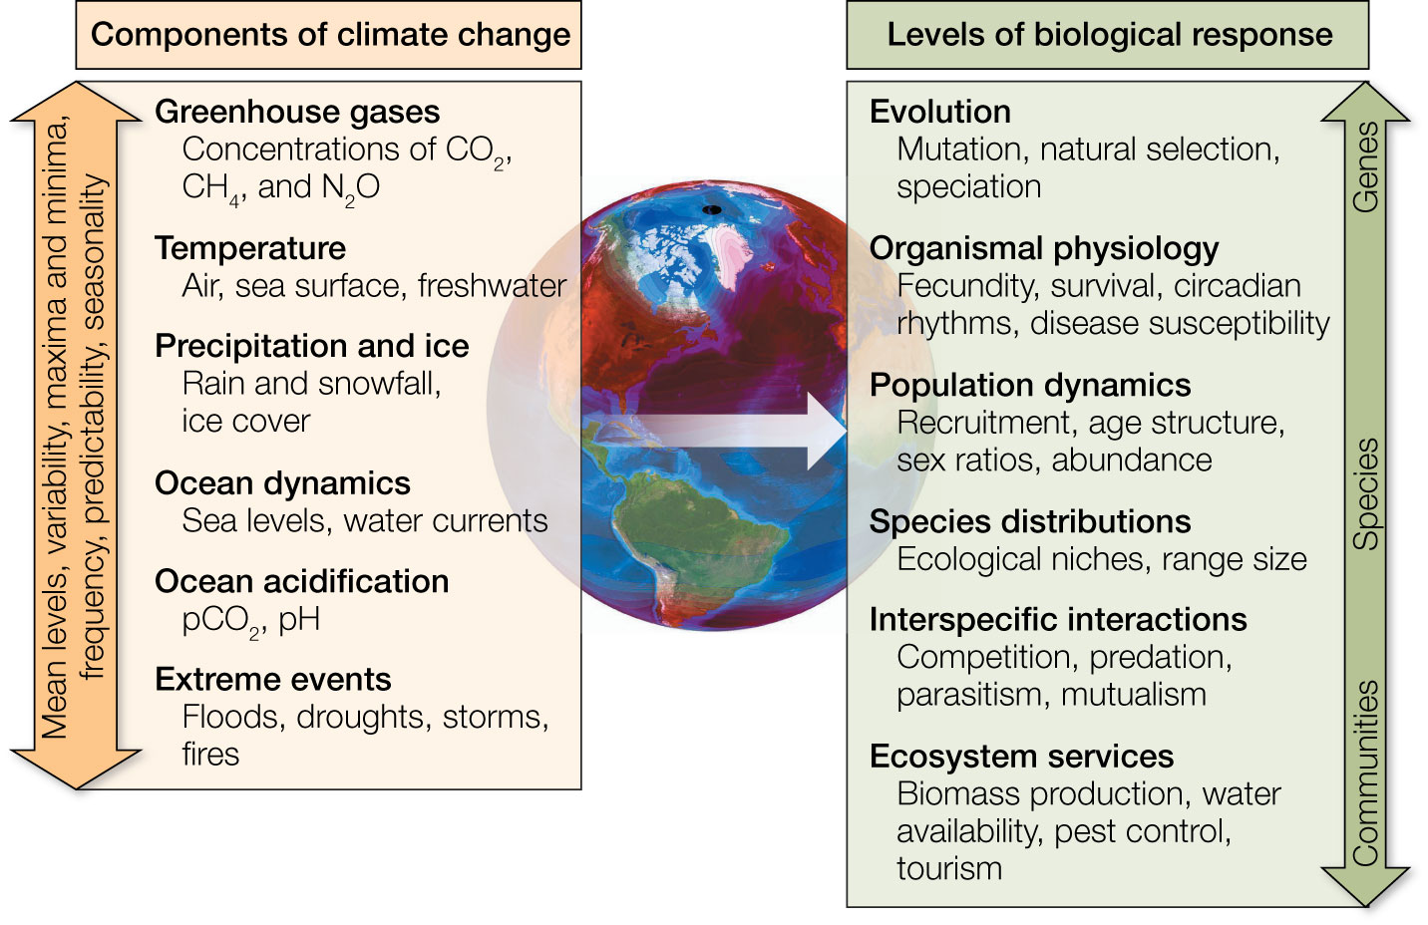
Figure 12.1 Climate change is a general term that refers to a suite of abiotic variables that are all changing across the globe in terms of their averages (mean levels), variability, ranges (maxima and minima), frequency, predictability, and seasonality.
Notes:
Figure 12.1 Climate change is a general term that refers to a suite of abiotic variables that are all changing across the globe in terms of their averages (mean levels), variability, ranges (maxima and minima), frequency, predictability, and seasonality. Because climate change represents a suite of variables that are changing in statistically distinct ways, it impacts nearly all biological processes, from genes to ecosystems.

Slide 4
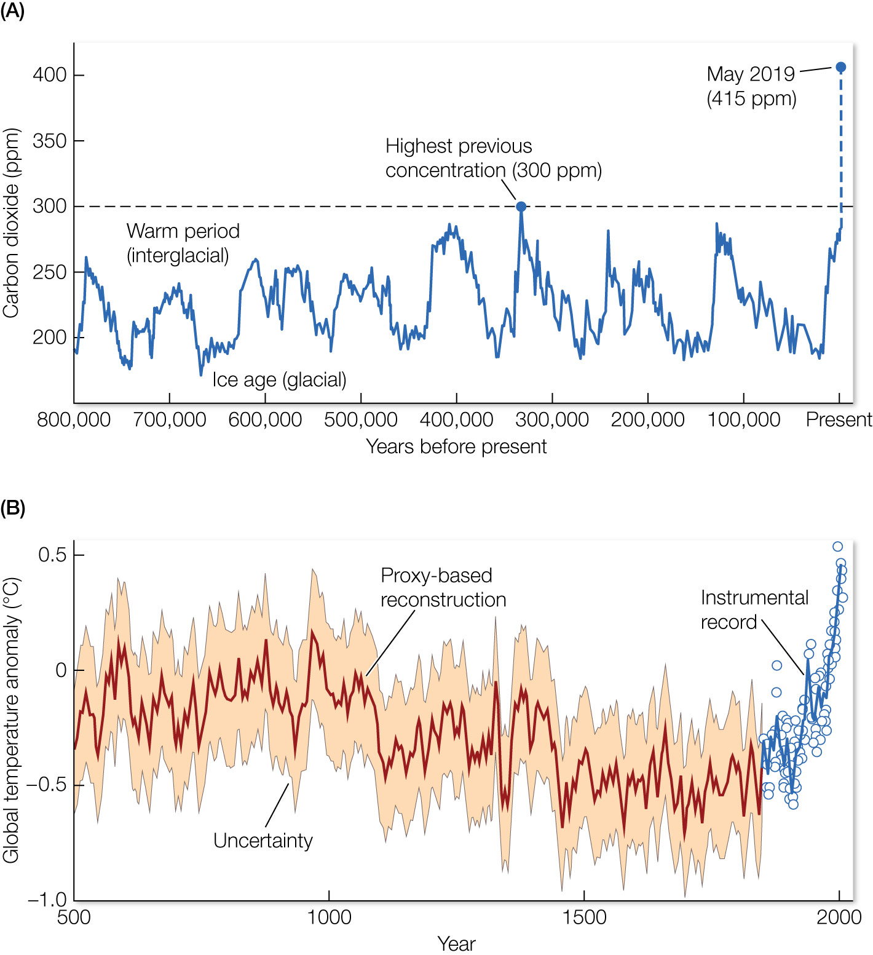
Figure 12.2 (A) Atmospheric carbon dioxide concentrations in parts per million (ppm) for the past 800,000 years. Peaks and valleys in CO₂ levels track the coming and going of ice ages (low CO₂ levels) and warmer interglacial periods (higher levels).
Notes:
Figure 12.2 (A) Atmospheric carbon dioxide concentrations in parts per million (ppm) for the past 800,000 years. Peaks and valleys in CO₂ levels track the coming and going of ice ages (low CO₂ levels) and warmer interglacial periods (higher levels). Throughout these cycles, atmospheric CO₂ was never higher than 300 ppm (horizontal black dashed line). However, in May 2019, concentrations of CO₂ reached a record high of 415.0 ppm (blue dot). (B) Temperature histories from paleoclimate data (solid line up to year 1850) compared to the history from 1850 to the present based on modern instruments (blue dots, with solid blue line showing the average). Note that global temperature is higher now than it has been in the past 1,500 years, and possibly longer.

Slide 5
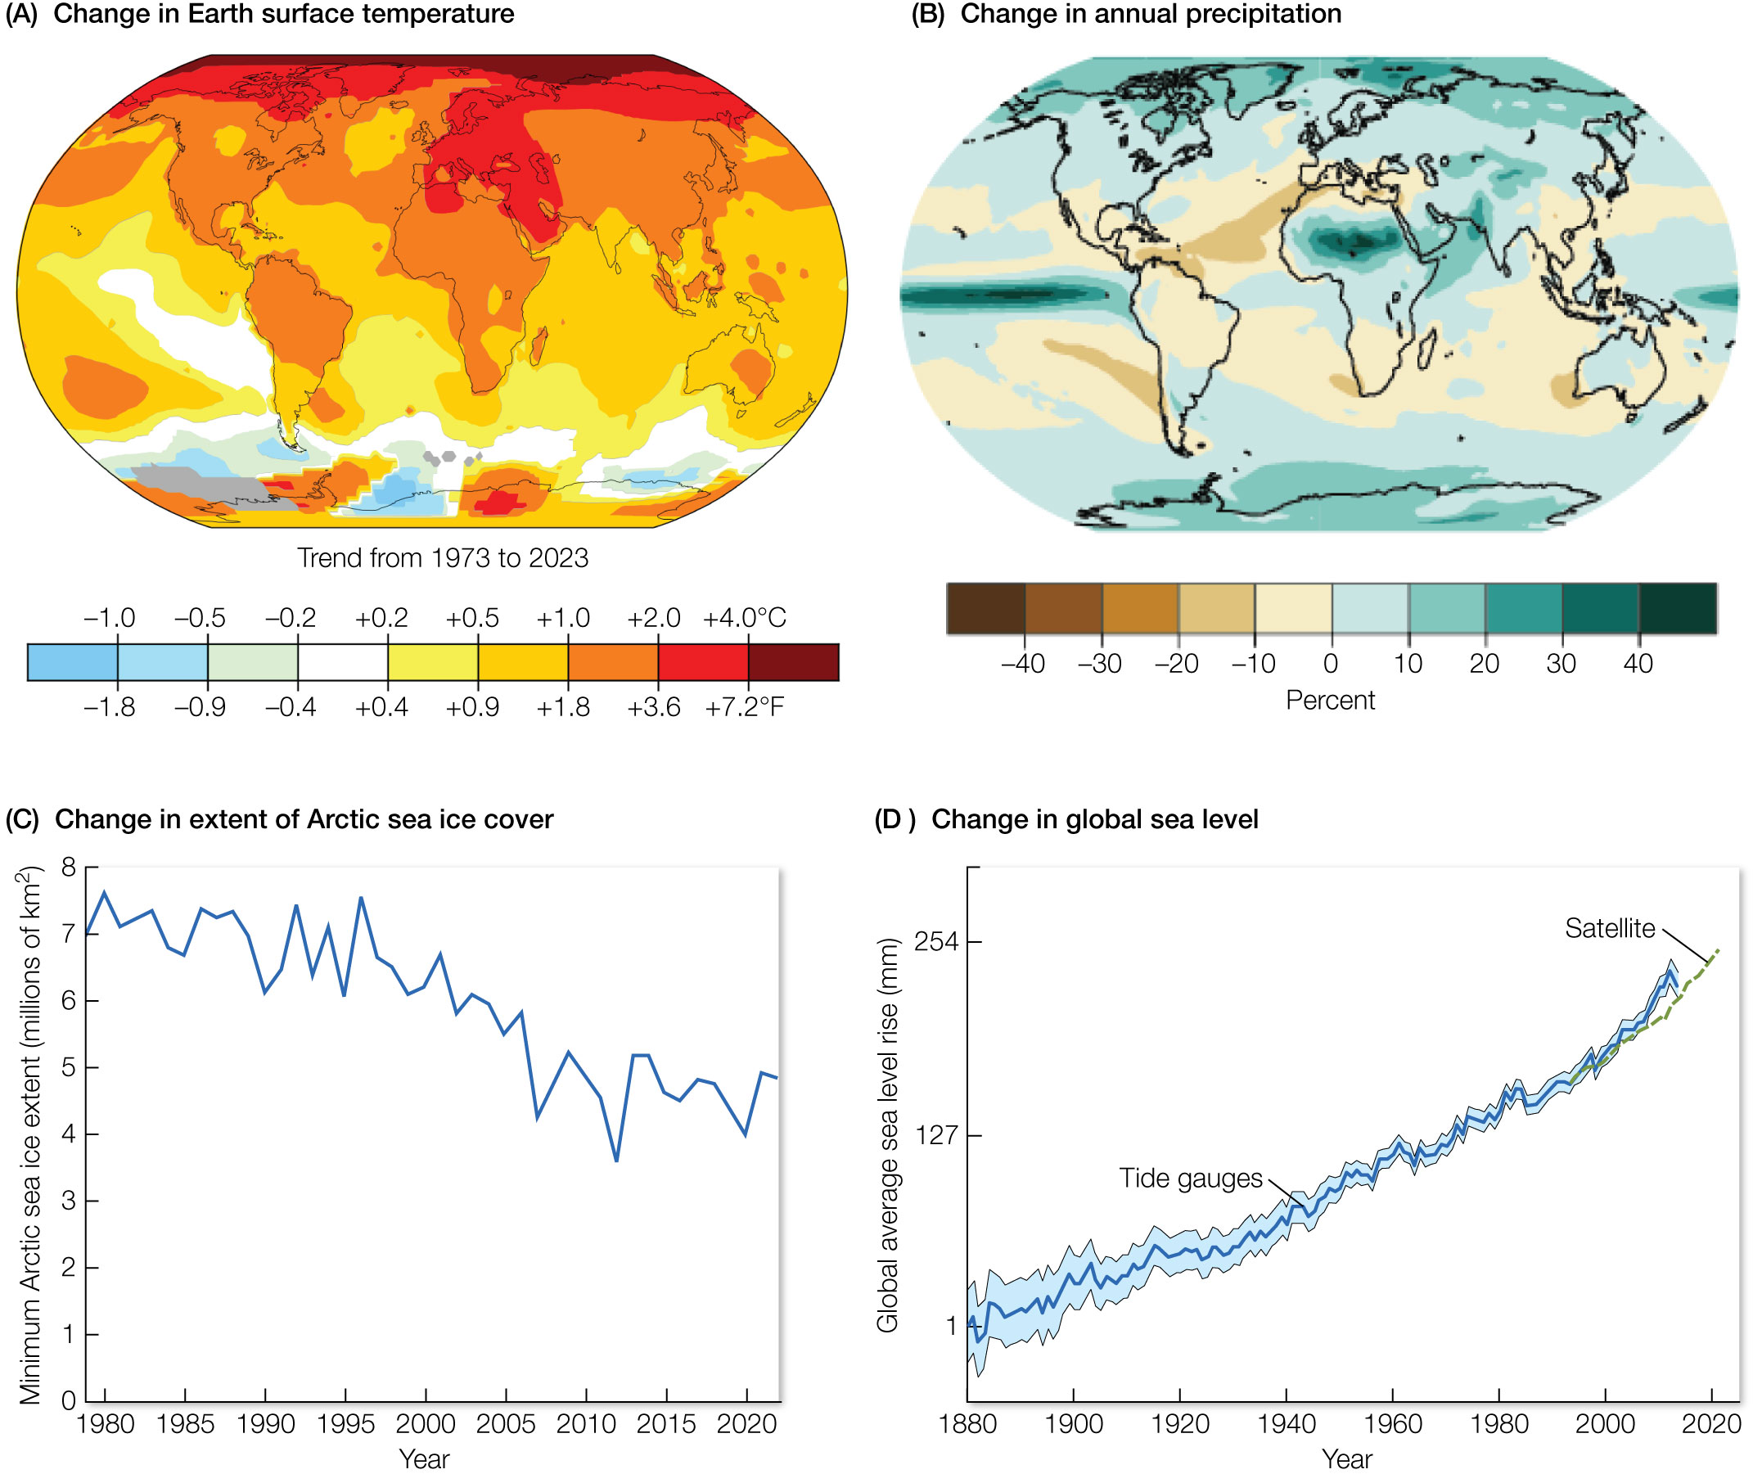
Figure 12.3 Changes in select abiotic variables that are being altered by climate change.
Notes:
Figure 12.3 Changes in select abiotic variables that are being altered by climate change. (A) Documented changes in Earth’s surface temperature. Color scale gives the average temperature for the period 2011–2021 relative to the widely used baseline 1956–1976. (B) Percentage change in annual precipitation over land associated with the 1.5°C temperature increase that is projected by 2040. (C) Extent of Arctic sea ice, in square kilometers, shown as the annual minima from 1979 to 2021. (D) Changes in global mean sea level from 1880 to 2021.

Slide 6
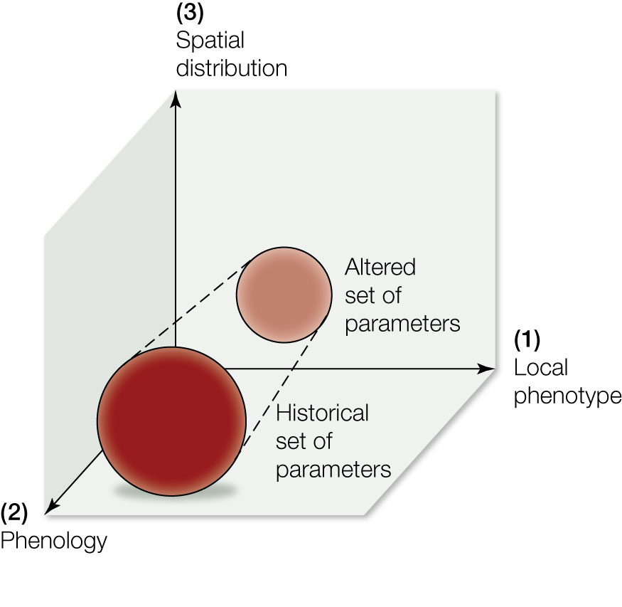
Figure 12.4 Potential responses that can allow a species to cope with climate change.
Notes:
Figure 12.4 Potential responses that can allow a species to cope with climate change. (1) Change in local phenotype: alteration of the species’ morphology, physiology, or behavior to be more adapted to local environmental conditions. (2) Change in phenology: adjusting life cycle events to match new climatic conditions. (3) Change in spatial distribution: populations shift to areas with more suitable habitat or change location on a microhabitat scale.

Slide 7
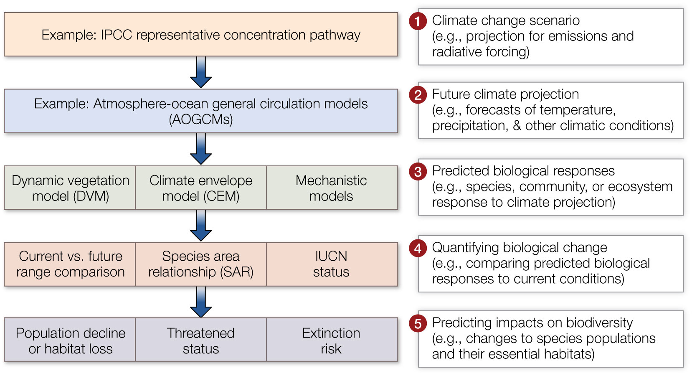
Figure 12.5 Five general steps for analyses that attempt to predict the response of species, communities, and ecosystems to climate change. IPCC, Intergovernmental Panel on Climate Change; IUCN, International Union for Conservation of Nature.
Notes:
Figure 12.5 Five general steps for analyses that attempt to predict the response of species, communities, and ecosystems to climate change. IPCC, Intergovernmental Panel on Climate Change; IUCN, International Union for Conservation of Nature.

Slide 8
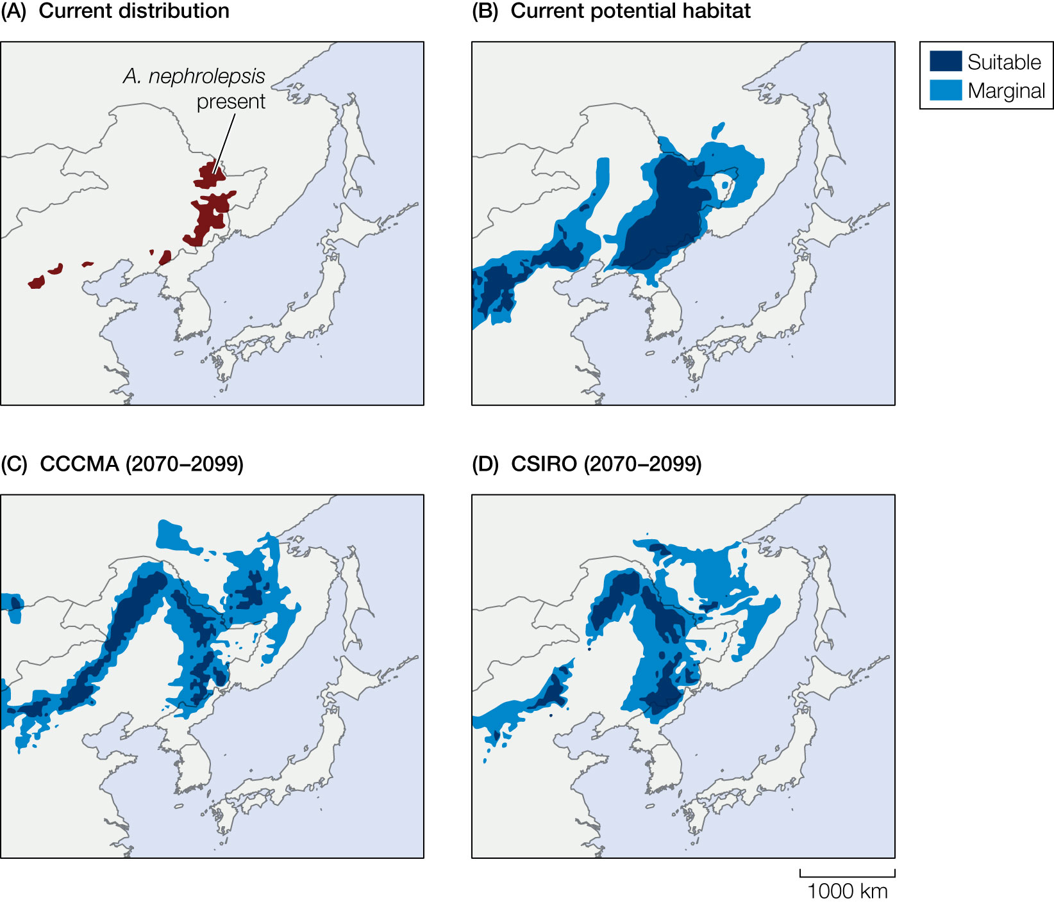
Figure 12.6 Example of results from climate envelope models. Map of the distribution in China
Notes:
Figure 12.6 Example of results from climate envelope models. Map of the distribution in China (A) and predicted potential habitats in East Asia (B) for Khingan fir (Abies nephrolepis) under the current climate. (C, D) Predicted changes in potential habitat for this species under two future climate scenarios (the Canadian Center for Climate Modelling and Analysis and the Commonwealth Scientific and Industrial Research Organization) for 2070 to 2099. The maps are depicted at approximately
20-km resolution.

Slide 9
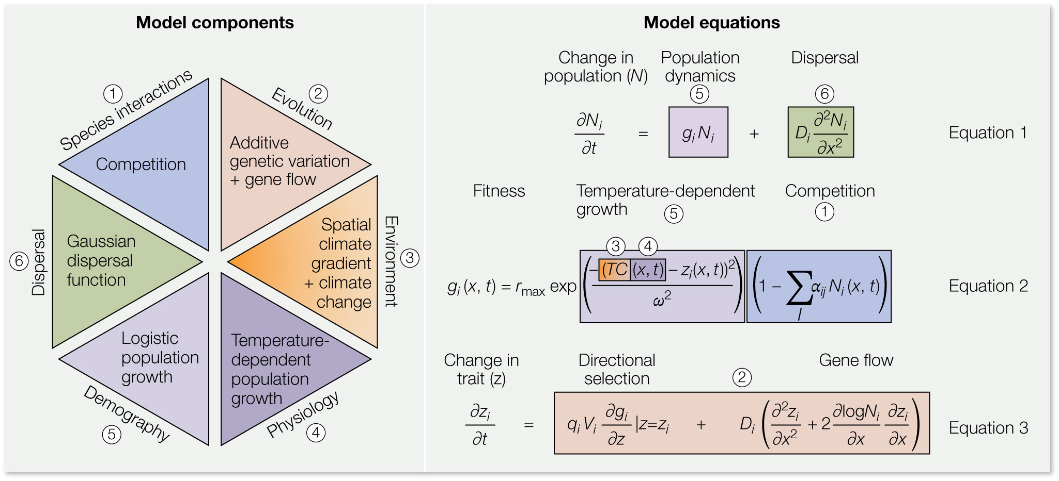
9
Notes:
A generalized mechanistic climate envelope model (left) that accounts for at least six biological components of a species’ response to climate change. The six components are matched by color to their representation in equations on the right. N = population size, i = species i (1 to I), t = time, g = fitness, D = diffusion constant for dispersal, x = spatial position along a single dimension, rmax = maximum intrinsic population growth rate, T = temperature, C = temperature change, z = temperature optimum for each species, ω = width of selection on thermal performance trait, α = strength of competition among species i and j, q = reduction in genetic variance at low population abundances, V = additive genetic variation in thermal optimum. (After M. C. Urban et al. 2016. Science 353: aad8466.)

Slide 10
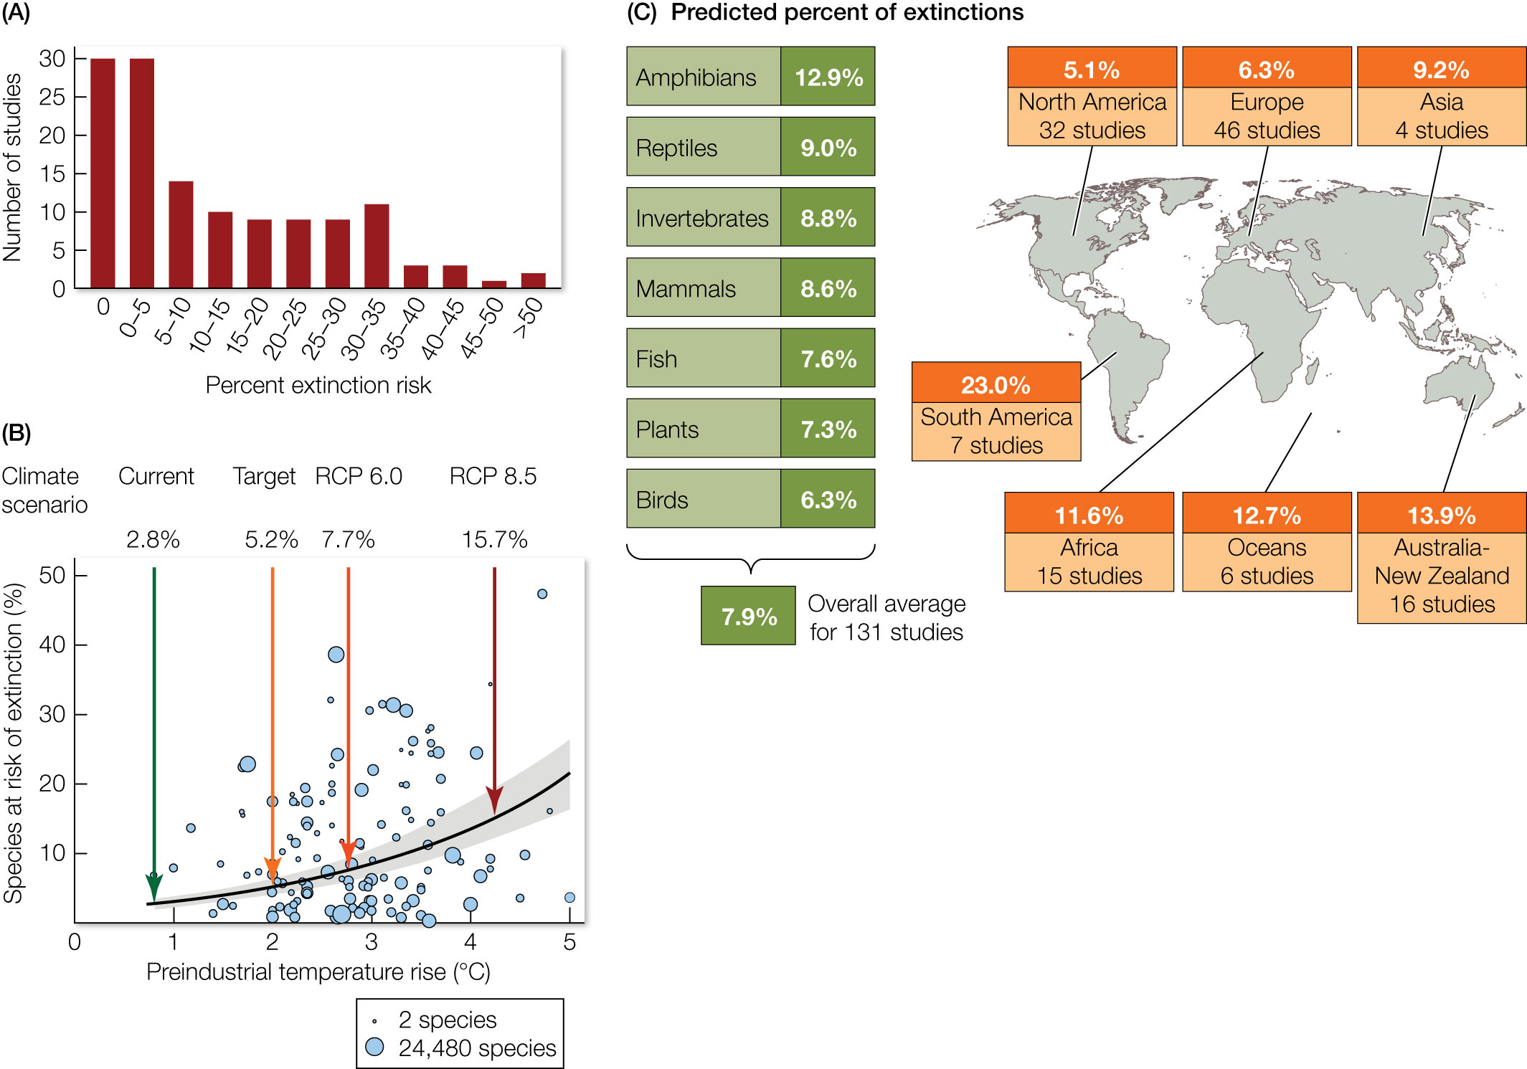
Figure 12.7 Summary of predicted impacts of climate change on biodiversity.
Notes:
Figure 12.7 Summary of predicted impacts of climate change on biodiversity. (A) Percentage of species at risk of extinction based on a synthesis of the predictions from 131 independent studies. The mean extinction risk from all studies is 7.9%, with a 95% confidence interval of 6.2% to 9.8%. (B) The predicted extinction risk from climate change depends on the future climate scenarios: the current postindustrial temperature rise of 0.8°C, the policy target of 2°C, and representative concentration pathways (RCPs) 6.0 and 8.5. The gray band indicates 95% confidence intervals for extinction risk. Circles are proportional to the number of species considered in each study. (C) Predicted extinction rates by taxonomic group (left) and geographic region (right).

Slide 11
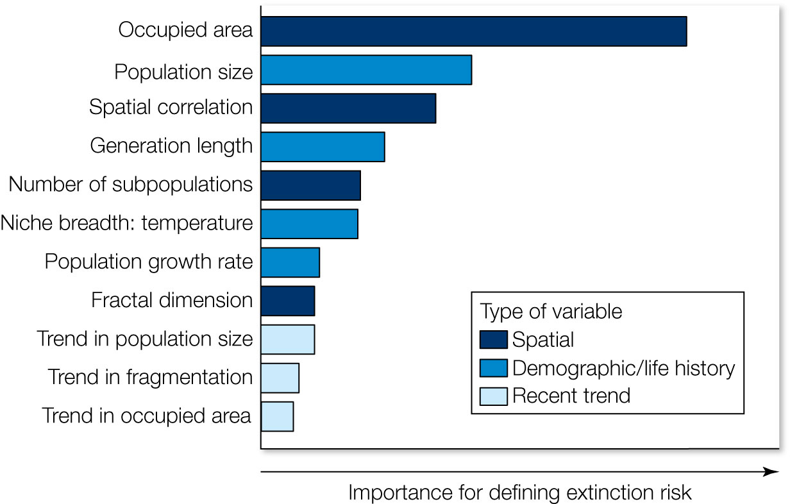
Figure 12.8 Ranked importance of the top predictors of extinction risk due to climate change based on climate envelope models for amphibian and reptile species.
Notes:
Figure 12.8 Ranked importance of the top predictors of extinction risk due to climate change based on climate envelope models for amphibian and reptile species. Predictors are categorized as spatial (darkest blue), demographic/life history traits, and recent historical trends (lightest blue).

Slide 12
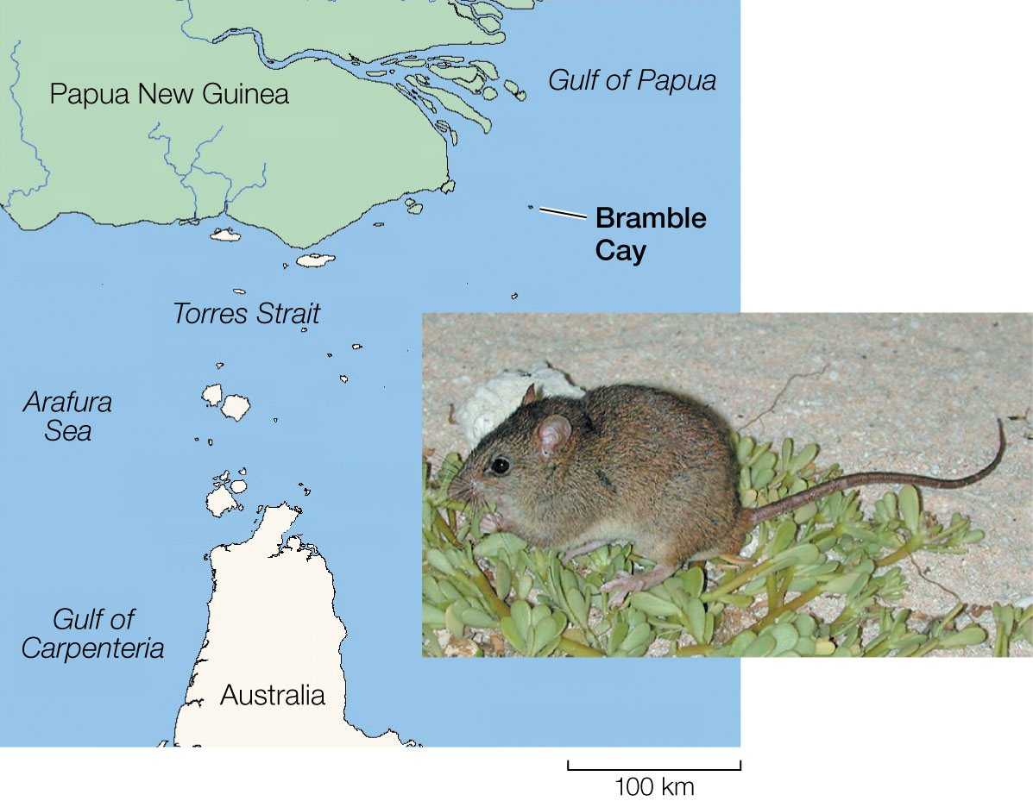
12
Notes:
The Bramble Cay melomys (Melomys rubicola) is the first known global extinction caused by climate change. The species was declared extinct after rising oceans repeatedly flooded its lone island habitat on Bramble Cay, Australia.

Slide 13
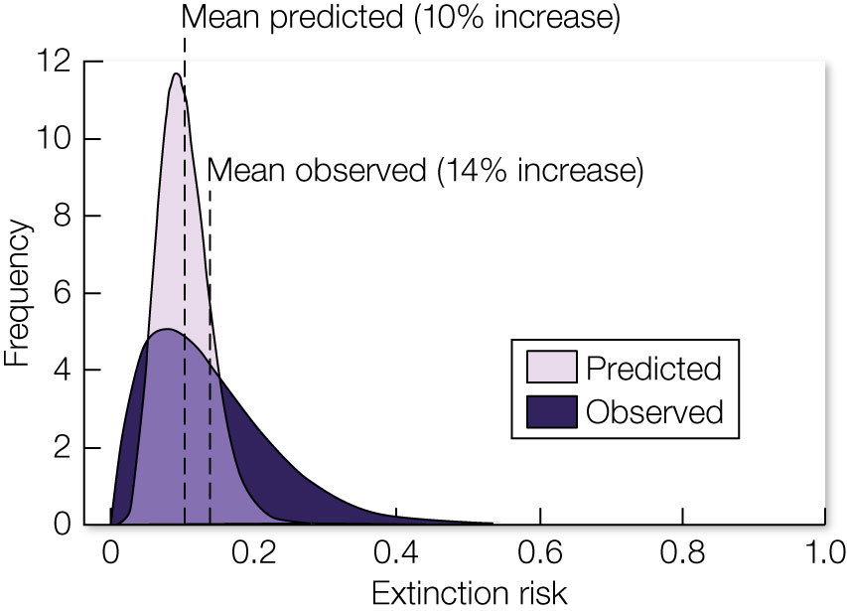
Figure 12.9 Observed versus predicted extinction risk caused by climate change.
Notes:
Figure 12.9 Observed versus predicted extinction risk caused by climate change. Frequency distributions comparing the observed increases in extinction risk caused by climate change to the risk predicted by models that forecast range constrictions and population declines of comparable taxa. This comparison indicates that current models can be quite accurate in predicting actual extinction risk.

Slide 14
TABLE 12.1 Examples of local extirpations caused by climate change
Species | Location | Proximate cause of local extirpation | Reference
American pika (Ochotona princeps) | Great Basin region, United States | Limited physiological tolerance to temperature extremes (both high and low) | E. A. Beever et al. 2010. Ecol Appl 20: 164;²⁴ E. A. Beever et al. 2011. Glob Change Biol 17: 164²⁵
Planarian (Crenobia alpina) | Wales, United Kingdom | Loss of prey resources and increased competition with other planarians as a result of increasing stream temperatures | I. Durance and S. J. Ormerod 2010. J. N. Am Benth Soc 29: 1367²³
Desert bighorn sheep (Ovis canadensis) | California, United States | Decreased precipitation led to altered plant community (food source) | C. W. Epps et al. 2004. Cons Biol 18: 102²⁶
Edith checkerspot butterfly (Euphydryas editha bayensis) | San Francisco Bay area, United States | Increase in variability of precipitation corresponding with reduction of temporal overlap between larvae and host plants | J. F. McLaughlin et al. 2002. Proc Natl Acad Sci 99: 6070²⁷
Clown goby (Gobiodon sp. A) | New Britain, Papua New Guinea | Destruction of obligate coral habitat due to coral bleaching caused by increasing water temperatures | P. L. Munday 2004. Global Change Biology 10: 1642²⁸
Spiny lizards (48 species from the genus Sceloporus) | Mexico | Increased maximum air temperature approaches physiological limit, seemingly causing decreased surface activity during the reproductive season | B. Sinervo et al. 2010. Science 328: 894²¹
Adrar mountain fishes (multiple genera and species) | Mauritania | Loss of water bodies due to drought | S. Trape 2009. PLoS One 4: e4400²²
Source: From A. E. Cahill et al. 2013. Proceedings of the Royal Society B 280: 9.²⁰
Notes:
TABLE 12.1 Examples of local extirpations caused by climate change

Slide 15
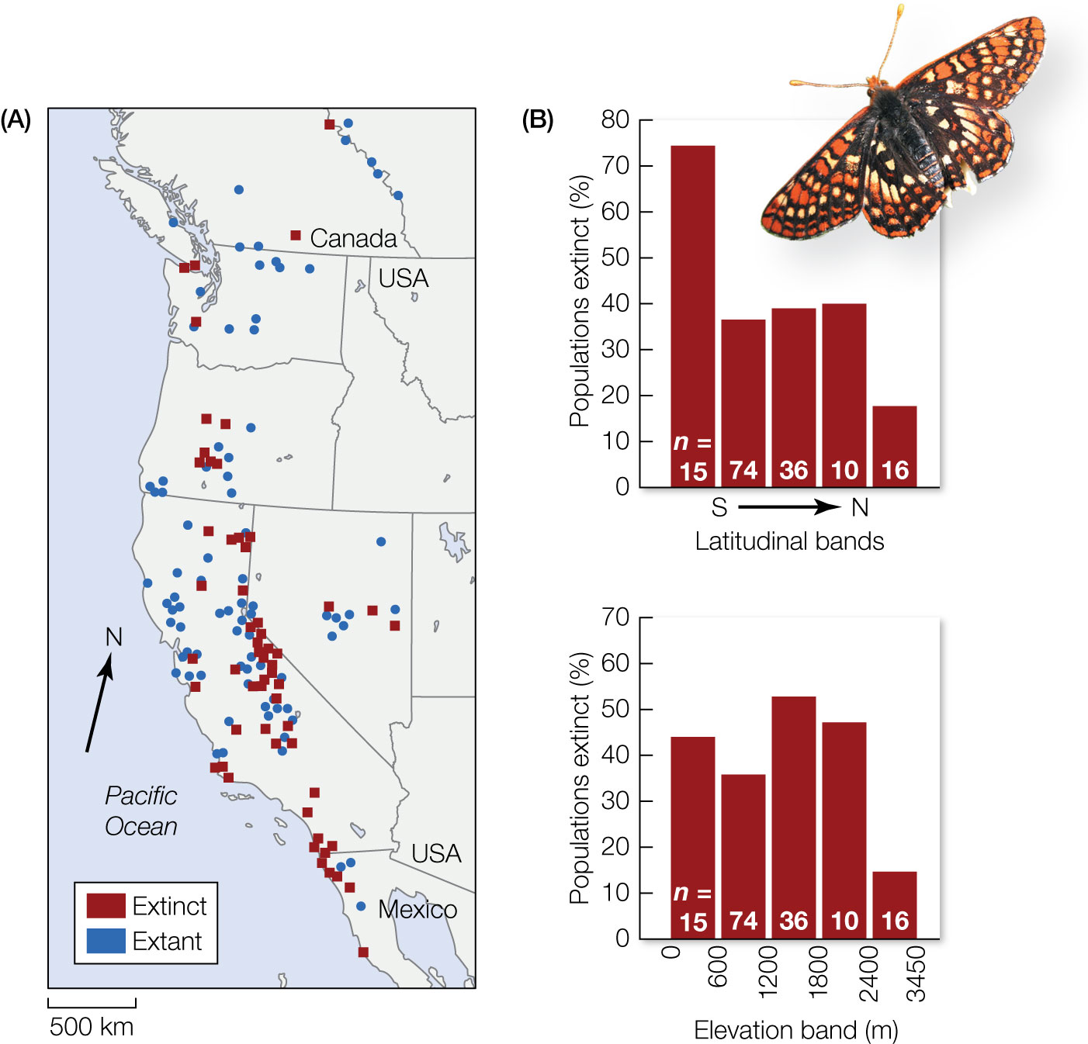
Figure 12.10 Geographic range shifts in the Edith checkerspot butterfly (Euphydryas editha).
Notes:
Figure 12.10 Geographic range shifts in the Edith checkerspot butterfly (Euphydryas editha). (A) A map of the distribution of the butterfly showing locations of extinct (red squares) versus extant (blue circles) populations. (B) Percentage population extinctions as a function of latitude (500 km top) and elevation (bottom).

Slide 16
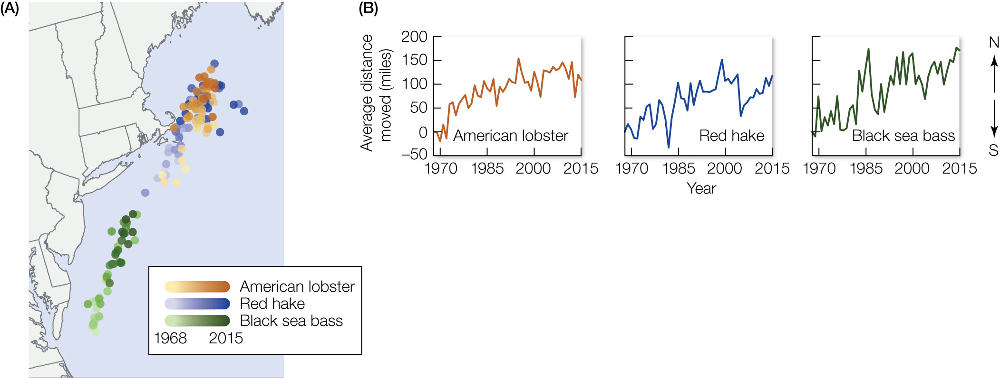
Figure 12.11 Range shifts in marine habitats.
Notes:
Figure 12.11 Range shifts in marine habitats. (A) Changes in the locations of populations of a crustacean (lobster) and two fish species (hake and sea bass) along the northeastern coast of the United States from 1968 to 2015. (B) Average distance moved (in miles) over the same time frame.

Slide 17
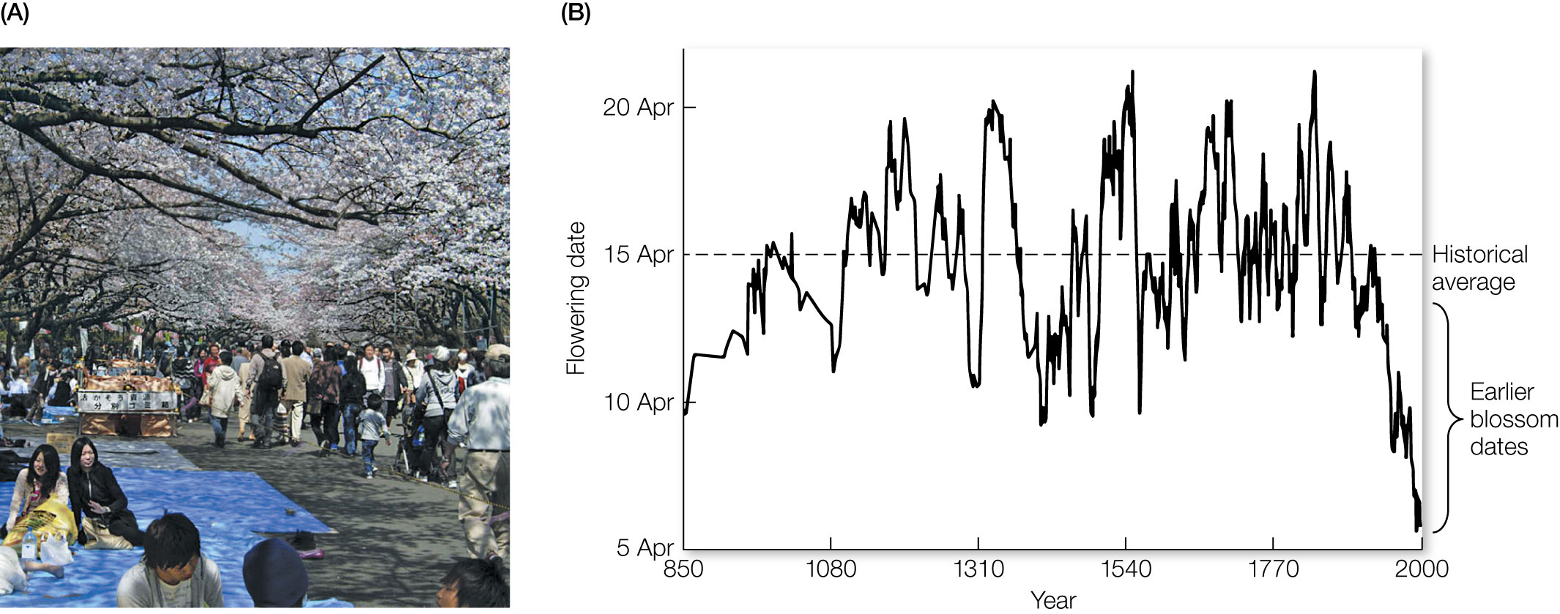
Figure 12.12 Cherry blossoms in Japan.
Notes:
Figure 12.12 Cherry blossoms in Japan. (A) People enjoying the cherry blossom festival in Ueono Park, a popular spot in the center of Tokyo. (B) Ten-year running averages of cherry blossoming dates in Kyoto. Each point represents the average of one year and the five flowering dates earlier and later than that date.

Slide 18
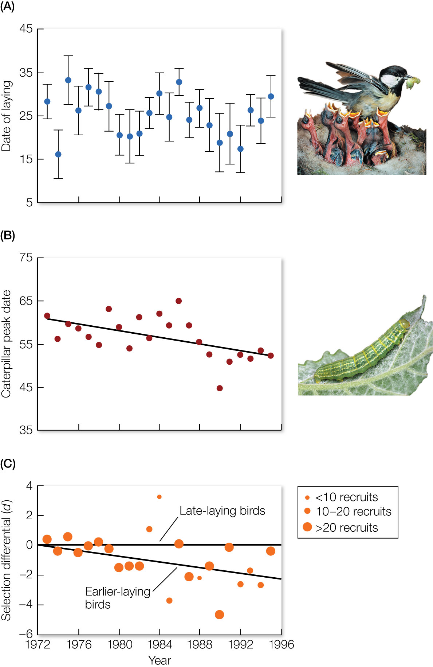
Figure 12.13 Example of a population asynchrony.
Notes:
Figure 12.13 Example of a population asynchrony. (A) Over time, the egglaying phenology of great tits has not changed in response to climate change. Numbers on the y axis indicate the number of days eggs have been laid after April 1. (B) However, the timing of reproduction of the bird’s primary food source—caterpillars—has responded to climate change, advancing by several days per decade (relative to April 1). (C) This asynchrony has led to selective pressure on the birds to shift the timing of their reproduction. In this study, based on the number of surviving offspring (recruits) per female, a negative selection differential indicates a selective advantage for earlier-laying birds.

Slide 19
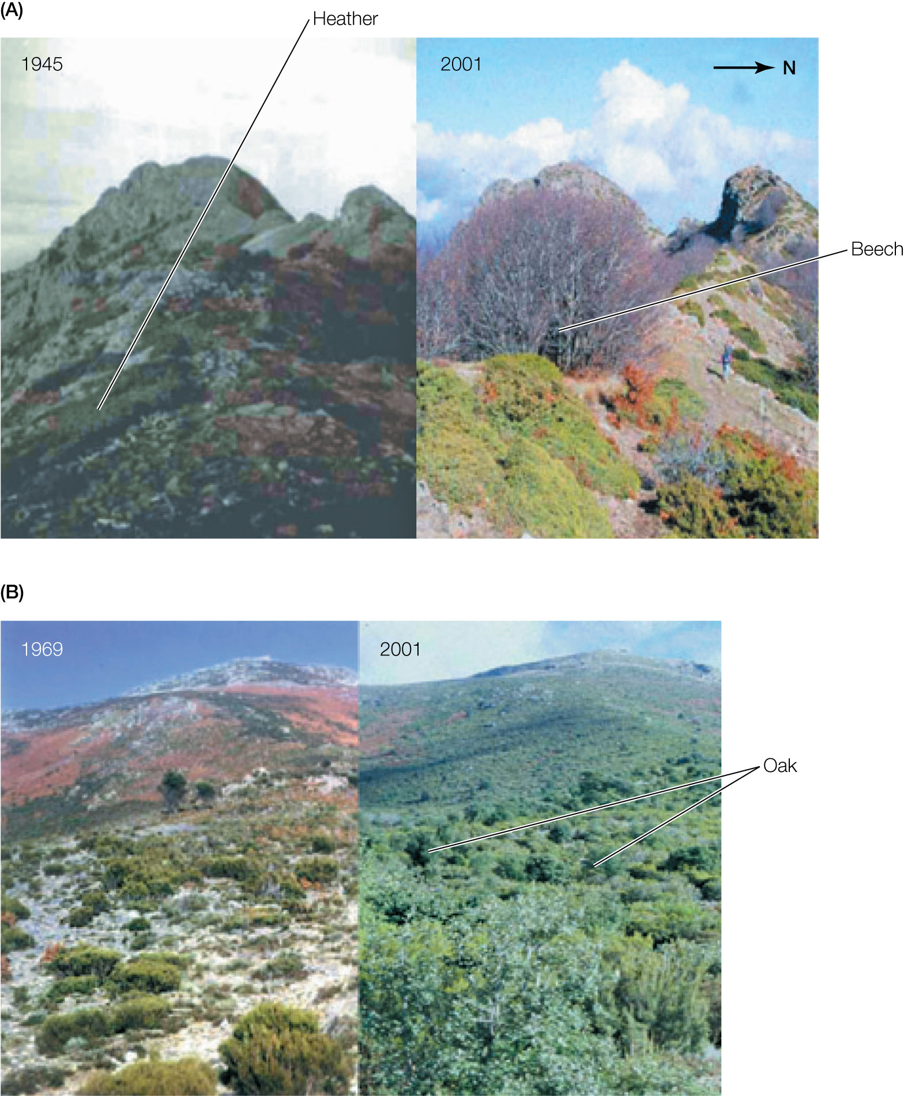
Figure 12.14 Climate-driven biome shift in the Montseny Mountains of Spain.
Notes:
Figure 12.14 Climate-driven biome shift in the Montseny Mountains of Spain. (A) Highelevation (1,700 m) heathland dominated by heather (Calluna vulgaris) is being replaced by a beech (Fagus sylvatica) forest that has undergone an altitudinal shift. (B) Mid-elevation (1,400 m) heathland and grassland are being replaced by a Mediterranean forest of broadleaf oak (Quercus ilex).

Slide 20
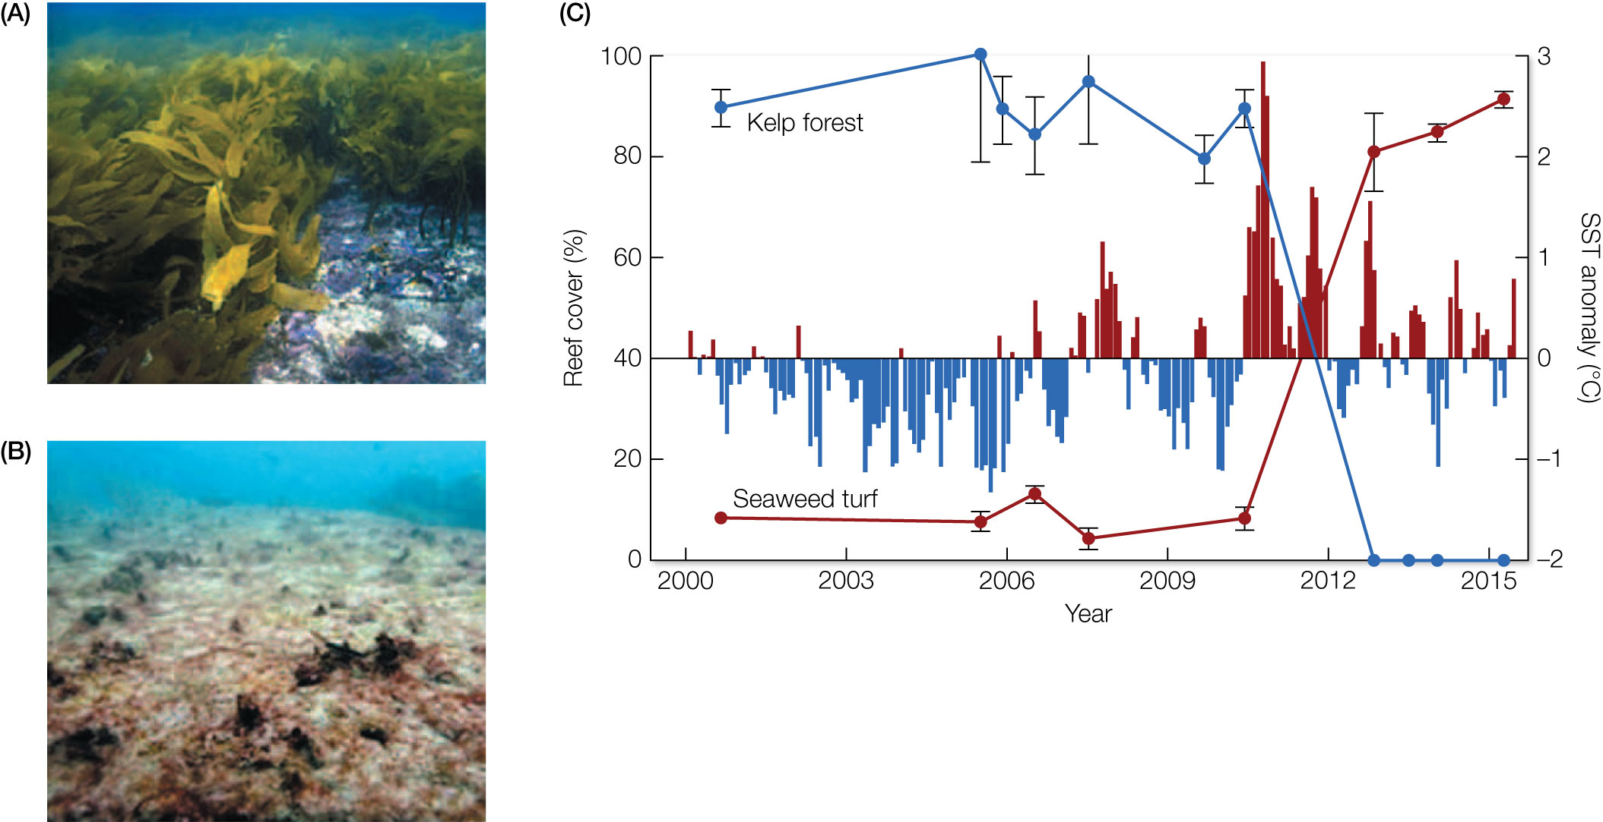
Figure 12.15 Climate-induced regime shift. Kelp forests
Notes:
Figure 12.15 Climate-induced regime shift. Kelp forests (A) were dense in Kalbarri, along the western coast of Australia, until 2011, when the kelps disappeared from hundreds of kilometers of coastline and were replaced by seaweed turfs (B). (C) The shift from kelp forest cover (blue line) to seaweed turf cover (red line) coincided with sea surface temperature (SST) anomalies (blue and red bars) that showed abnormally warm ocean temperatures from 2011 to 2013.

Slide 21
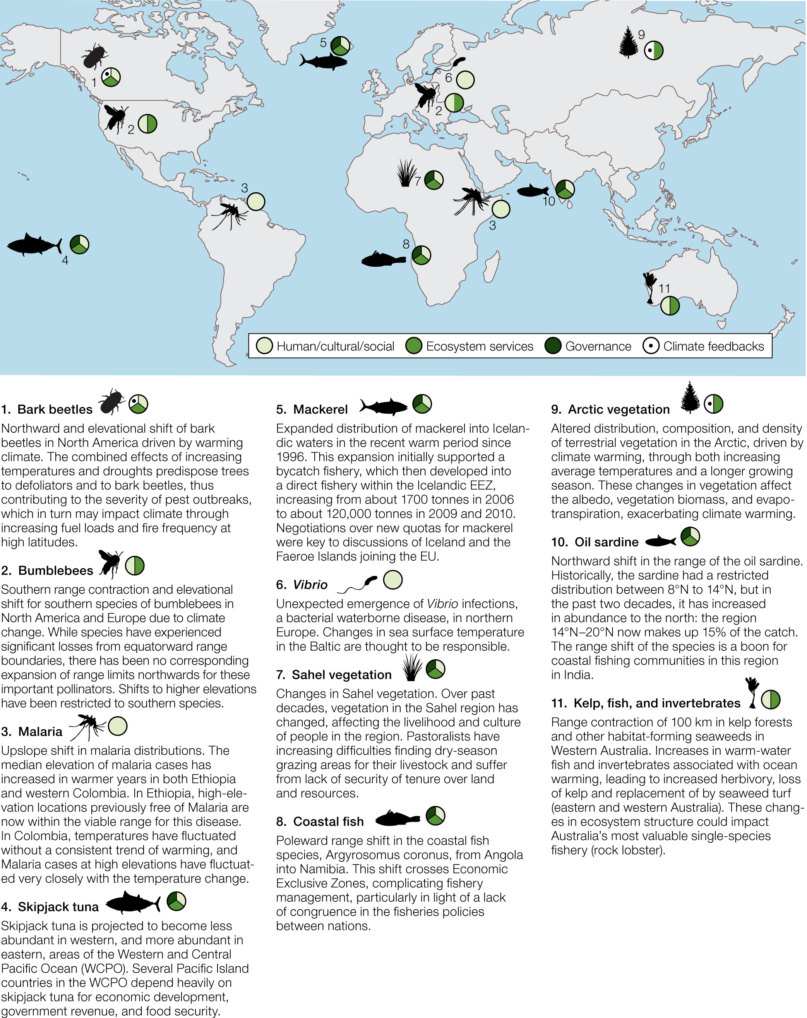
Figure 12.16 Several examples of how climate-driven changes in species distributions have already begun to impact human physical, social, or cultural well-being (lightest green), ecosystem services (medium green),
Notes:
Figure 12.16 Several examples of how climate-driven changes in species distributions have already begun to impact human physical, social, or cultural well-being (lightest green), ecosystem services (medium green), governance systems (darkest green), and feedbacks that reinforce the rate of climate change (white with dots).

Slide 22
TABLE 12.2 Examples of freely available tools that can be used to answer key management questions about the effects of climate change on species and their habitats
Question | Tool | Scale | Variables
How is climate projected to change? | WorldClim | Global | Temperature, precipitation, solar radiation, wind speed, water vapor pressure, other bioclimatic variables
 | ClimateData | Regional (United States) | Temperature, precipitation
How vulnerable is the species to climate change? | System for Assessing Vulnerability of Species | Global | Projected habitat change, life history traits
 | Climate Change Vulnerability Index | Regional (United States) | Sensitivity to changes in temperature, precipitation, and landscape change; life history traits
How is the species’ range likely to change? | MaxEnt | User-defined | Species occurrence, user’s choice of environmental and climatic variables
 | Climate Change Atlas | Regional (United States, terrestrial) | Species occurrence, temperature, precipitation, elevation
 | OceanAdapt | Regional (United States, marine) | Species occurrence, latitude, depth, temperature
How will management options affect species persistence? | NatureServe Vista | User-defined | User’s choice
 | Marxan | User-defined | User’s choice
How will climate change affect the connectivity of populations? | Circuitscape | User-defined | Resistance to movement, user’s choice of environmental and climate variables
Source: Adapted from B. Abrahms et al. 2017. Biodivers Conserv 26: 2277–2293.
Notes:
TABLE 12.2 Examples of freely available tools that can be used to answer key management questions about the effects of climate change on species and their habitats

Slide 23
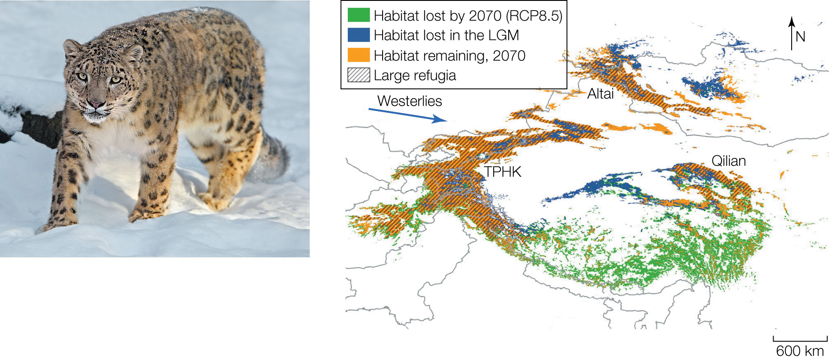
Figure 12.17 Climate envelope models (CEMs) have been used to describe the modern climatic niche of snow leopards (Panthera uncia).
Notes:
Figure 12.17 Climate envelope models (CEMs) have been used to describe the modern climatic niche of snow leopards (Panthera uncia). When researchers overlaid the results of CEMs onto projections of global climate models, they were able to identify habitat already lost during the Last Glacial Maximum (LGM; blue, mostly in Qilian and Altai), habitat that will be lost by 2070 (green, south of Qilian), habitat that should persist (orange, multiple locations but mostly in the western part near TPHK [Tian Shan–Pamir–Hindu Kush–Karakoram mountain range] and north near Altai), and large climate refugia (hatched, mostly in the western part near TPHK and north near Altai) that should exist in 2070 and could allow the species to persist if conserved.

Slide 24
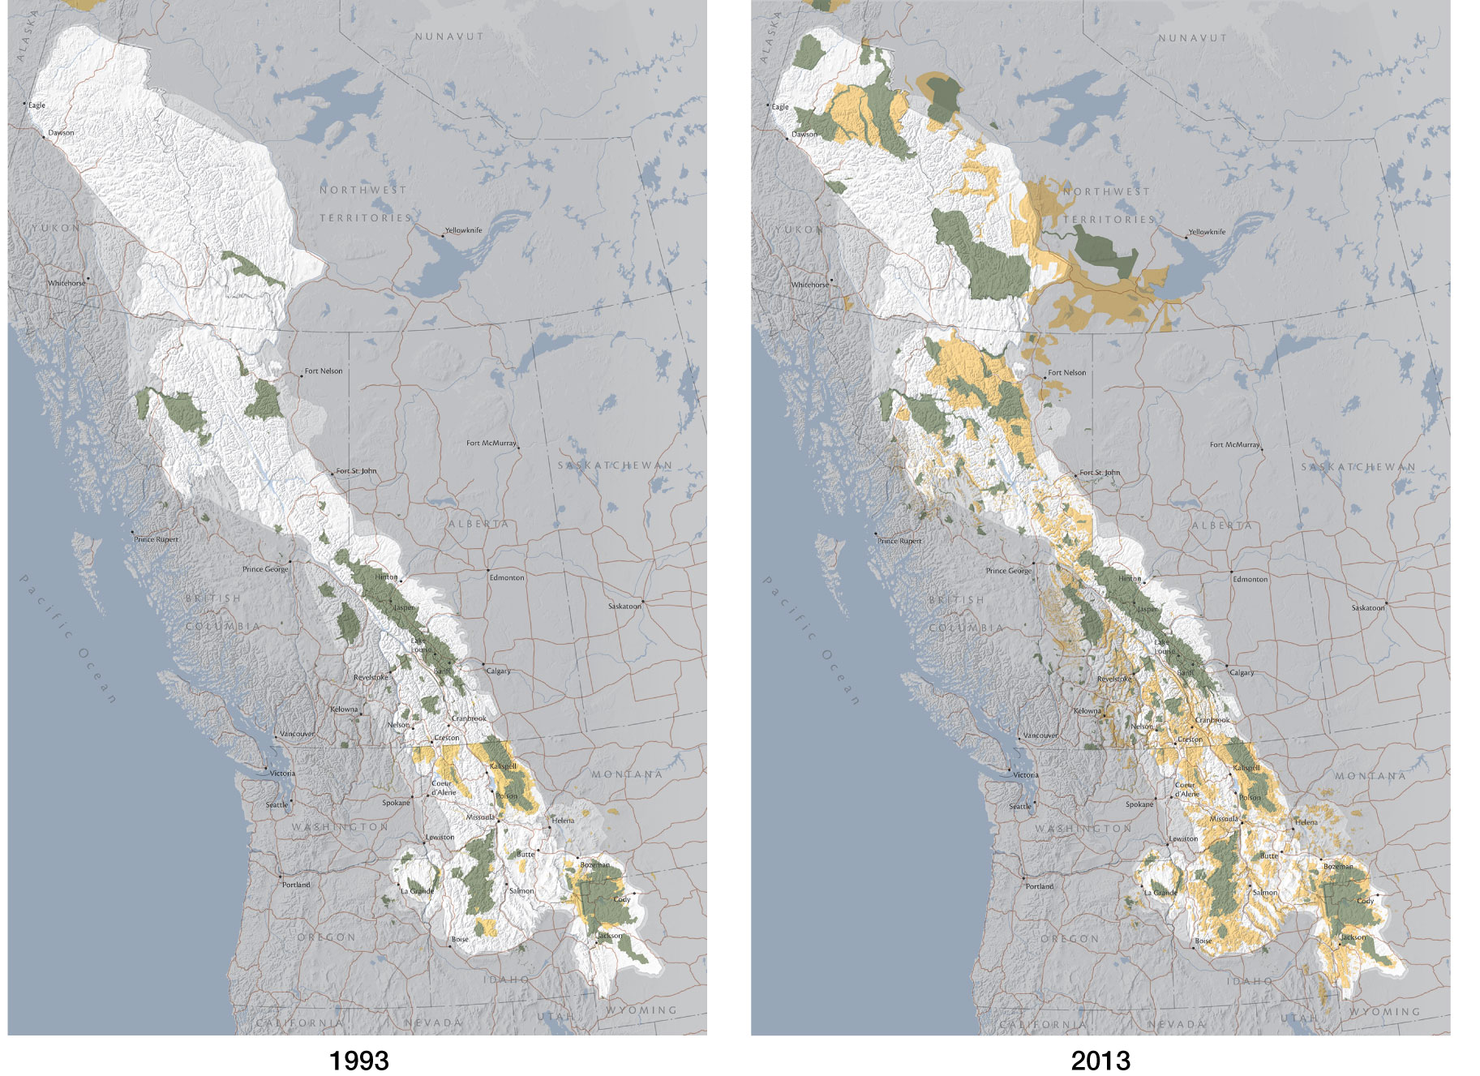
Figure 12.18 The Yellowstone to Yukon (Y2Y) Conservation Initiative is a project designed to allow north–south and east–west migration pathways between protected areas for large organisms
Notes:
Figure 12.18 The Yellowstone to Yukon (Y2Y) Conservation Initiative is a project designed to allow north–south and east–west migration pathways between protected areas for large organisms (e.g., American bison, boreal caribou) that migrate seasonally or that are shifting distributions in response to climate change. The two images show the area before (1993) and after (2013) the Y2Y initiative was established. Green areas indicate protected lands, such as provincial parks and wilderness preserves. Yellow areas indicate other conservation designations, including but not limited to provincial natural areas, special management zones, and restricted-use wilderness areas.

Slide 25
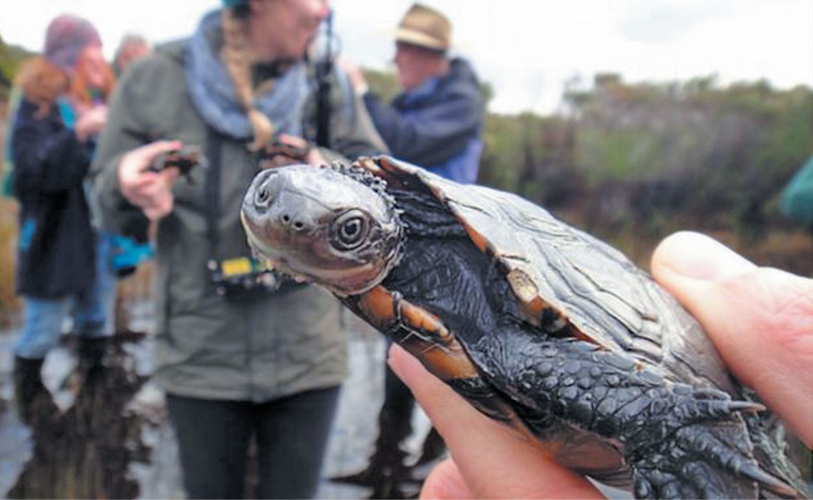
25
Notes:
The tiny western swamp turtle (Pseudemydura umbrina), Critically Endangered as a result of habitat loss and invasive alien species, is now also threatened by anthropogenic climate change.

Slide 26
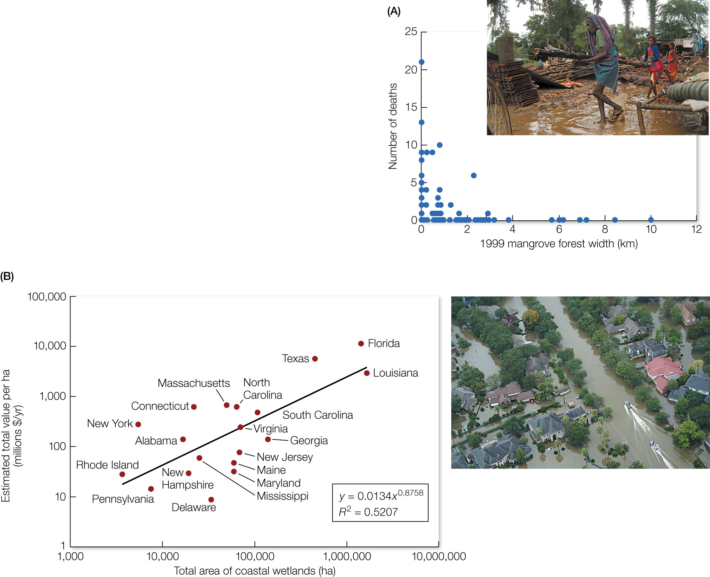
Figure 12.19 Natural infrastructure can help mitigate natural disasters like floods, which are increasing in frequency and magnitude as a result of anthropogenic climate change.
Notes:
Figure 12.19 Natural infrastructure can help mitigate natural disasters like floods, which are increasing in frequency and magnitude as a result of anthropogenic climate change. (A) The number of deaths following the 1999 “supercyclone” that hit Orissa, India, was substantially lower (near zero, in fact) in areas where mangrove forests provided extensive flood protection. (B) Property damage costs are substantially reduced in coastal cities that protect wetlands, since wetlands serve as a “sponge” that can protect people from the worst impacts of flooding. This graph shows the total value of coastal wetlands per hectare for avoiding property damage after storms.

Slide 27
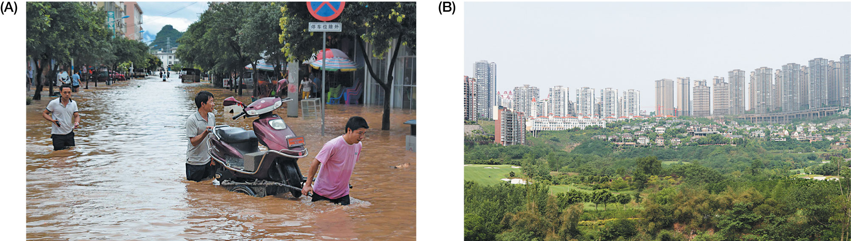
27
Notes:
(A) Because of rapid urbanization and the spread of impervious surfaces, many large cities in China experience massive flooding during rainstorms. (B) China’s Sponge City Program is a bold initiative to replace impervious surfaces with green infrastructure that serves as water storage and flood control.

